Slide 1

Global Technologies
XD12
The LED Current Sink Driver IC
12 Channels
General Description
The XD12 is a compact IC featuring 12-channel current sink control drivers optimized for LED lighting solution. The XD12 driver is used together with a XC24 controller as a companion chip. A lot of the XD12 drivers can be daisied each other to the XC24 channels and controlled through a serial interface by a XC24 controller.
The XD12 supports monitoring the fault event, a feedback control for the LED power efficiency, a self-protection features like as a Thermal/LED OPEN/SHORT, and Over/Under-Voltage detection.
Application
LED back-lighting with local dimming control

Slide 2
XD12
Feature
Bi-directional 1-wire interface and configurable transmit rate
Daisied connection between devices and pin layout for designing single layer PCB
12 independent dimming control channels in a package
Maximum 40V headroom voltage
Configurable device’s max output current level (4/8/12/16/24/32/46/64mA)
12-bit DAC global max current control
16-bit DC brightness control
Support configurable black sub-frame insertion
Sink current accuracy ±2% (Configured max current * 1)
Sync controllability between devices
Configurable LED OPEN detection and protection
Configurable LED SHORT detection level (3/4/6/8/12/16/24/36V) and protection
Configurable FB operation level (0.4/0.5/0.6/0.7/0.85/1.0/1.15/1.3V)
Configurable Over-Temperature @ 135℃
Configurable Over/Under-Voltage of internal LDO
Supply voltage 4.5 ~ 5.0V
24-PIN QFN 3030 package
Latch-up Immunity, I_{LATCH} (JEDEC JESD78D Nov 2011) : ±100mA
ESD protection, ESD_{HBM} (Norm: MIL 883 E Method 3015 Human Body Model) : ±2KV

Slide 3
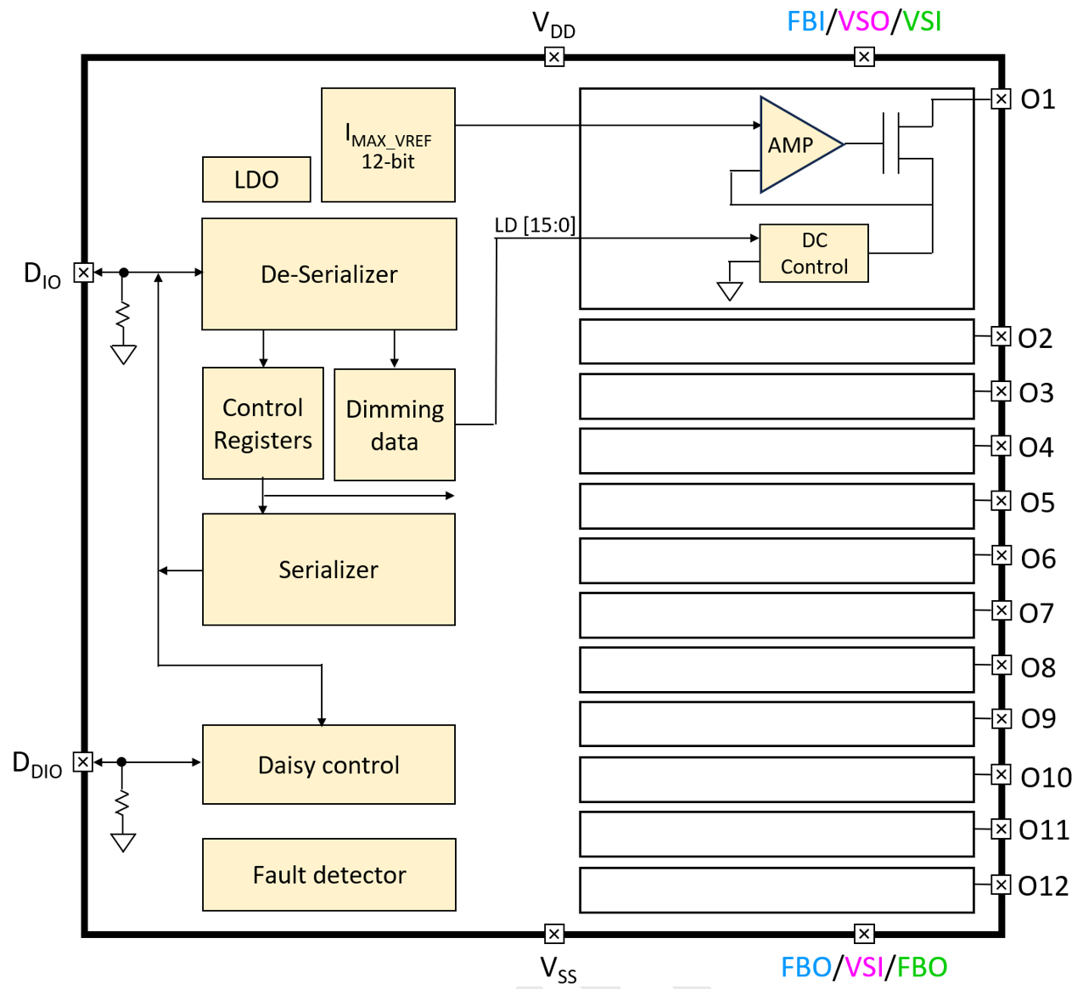
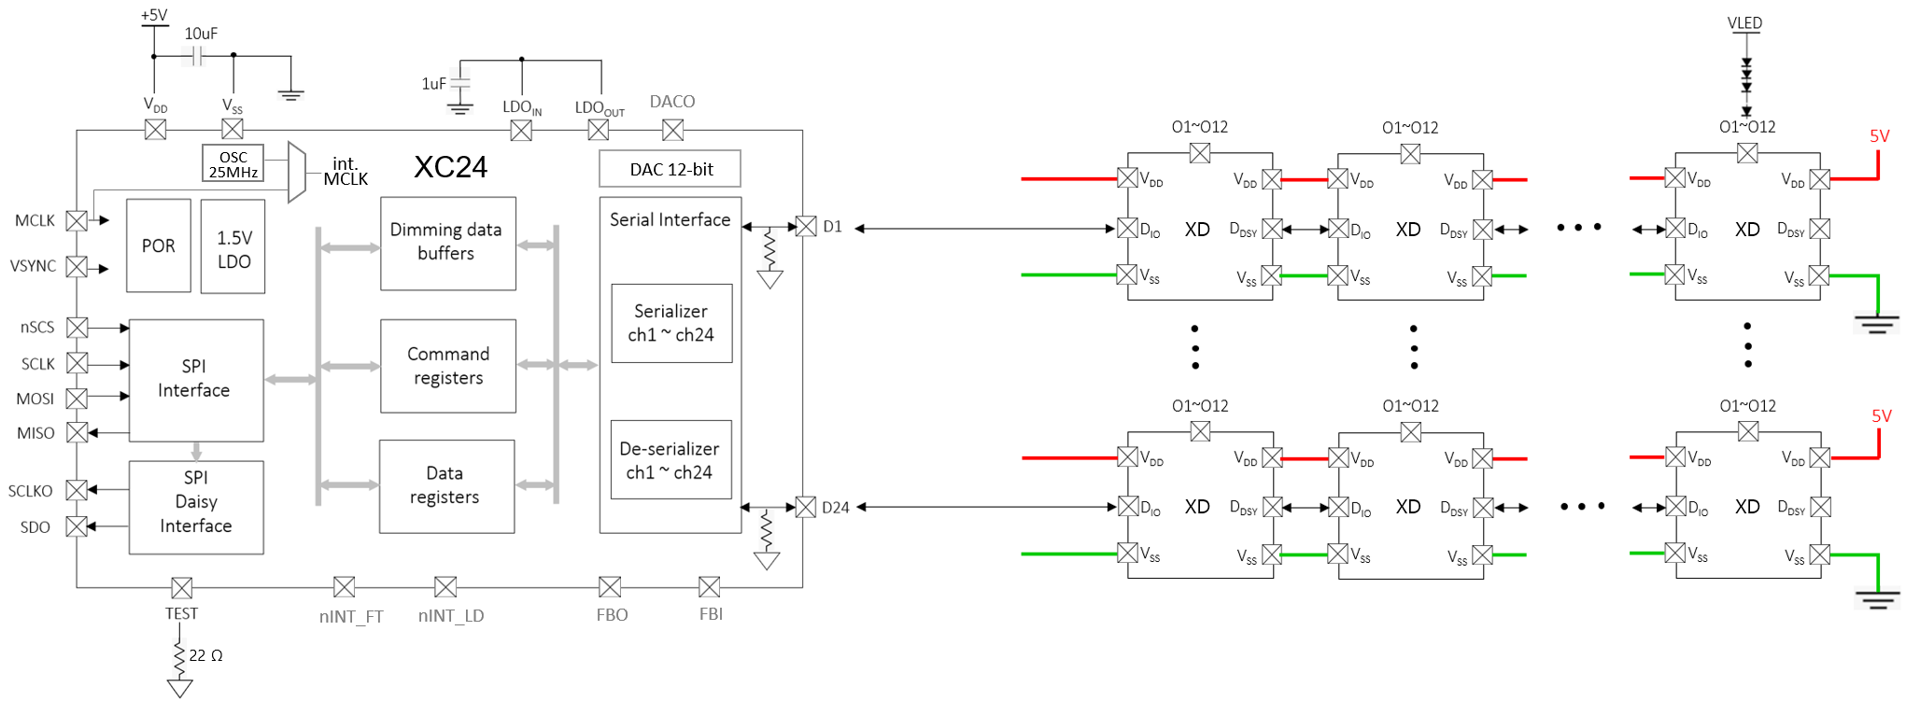
XD12
Block Diagram
Figure 1. Block Diagram
Application Circuit
Figure 2. Application Circuit

Slide 4
XD12
Pin diagram (Top View)
18
17
16
15
14
13
V_{DD}
V_{DD}
V_{SS}
V_{SS}
FBI/
VSO/
VSI
D_{DIO}
O11
O12
O9
O10
20
21
22
O7
23
T-Pad
8
O8
9
10
11
19
24
7
O6
12
O5
O3
O4
O1
V_{DD}
V_{SS}
V_{SS}
V_{SS}
FBO/
VSI/
FBO
D_{IO}
O2
1
2
3
4
5
6
Fig. 3 Pin diagram
Pin description
Pin Name | Pin No. | I/O | Type | Description | Remark
V_{DD} | 1 | - | Power | Supply voltage
V_{SS} | 2 | - | GND | Ground
V_{SS} | 3 | - | GND | Ground
V_{SS} | 4 | - | GND | Ground
FBO/VSI/FBO ¹⁾ | 5 | I/O | Digital | FBO/ VSI/ FBO (Configurable through IO_MODE) | FBO is Open-drain output If not used, connect to GND
D_{IO} | 6 | I/O | Digital | Data In/Out | Internal PD, 48KΩ
O2 | 7 | O | Current Load | Current Sink 2 | If unused, connect to GND
O4 | 8 | O | Current Load | Current Sink 4 | If unused, connect to GND
O6 | 9 | O | Current Load | Current Sink 6 | If unused, connect to GND
O8 | 10 | O | Current Load | Current Sink 8 | If unused, connect to GND
O10 | 11 | O | Current Load | Current Sink 10 | If unused, connect to GND
O12 | 12 | O | Current Load | Current Sink 12 | If unused, connect to GND
D_{DIO} | 13 | I/O | Digital | Daisied Data In/Out | Internal PD, 48KΩ
FBI/VSO/VSI ¹⁾ | 14 | I/O | Digital | FBI/ VSO/ VSI (Configurable through IO_MODE) | If not used, connect to GND

Slide 5

XD12
Pin description
Pin Name | Pin No. | I/O | Type | Description | Remark
V_{SS} | 15 | - | GND | Ground
V_{SS} | 16 | - | GND | Ground
V_{DD} | 17 | - | Power | Supply Voltage
V_{DD} | 18 | - | Power | Supply Voltage
O11 | 19 | O | Current Load | Current Sink 11 | If unused, connect to GND
O9 | 20 | O | Current Load | Current Sink 9 | If unused, connect to GND
O7 | 21 | O | Current Load | Current Sink 7 | If unused, connect to GND
O5 | 22 | O | Current Load | Current Sink 5 | If unused, connect to GND
O3 | 23 | O | Current Load | Current Sink 3 | If unused, connect to GND
O1 | 24 | O | Current Load | Current Sink 1 | If unused, connect to GND
Note : 1) The pin function can be configured through the IO_MODE register bits. If the pin will be used as the FBO,
then the pin acts as an Open-drain output. (external PU resistor should be attached)
Table 1. Pin Description
Equivalent Circuits of individual pins
Pad Name | I/O | Internal Circuit | Description
D_{IO} | I/O |  | Data In/Out
D_{DIO} | I/O |  | Daisied Data In/Out

Slide 6
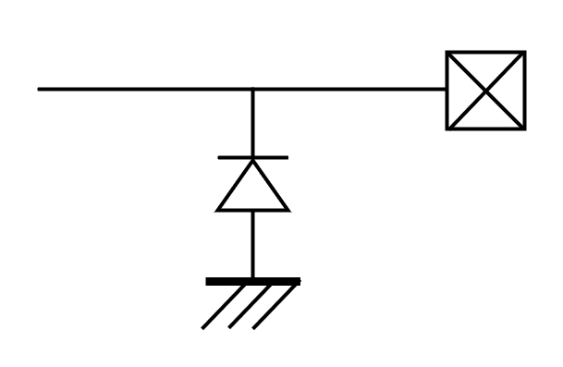

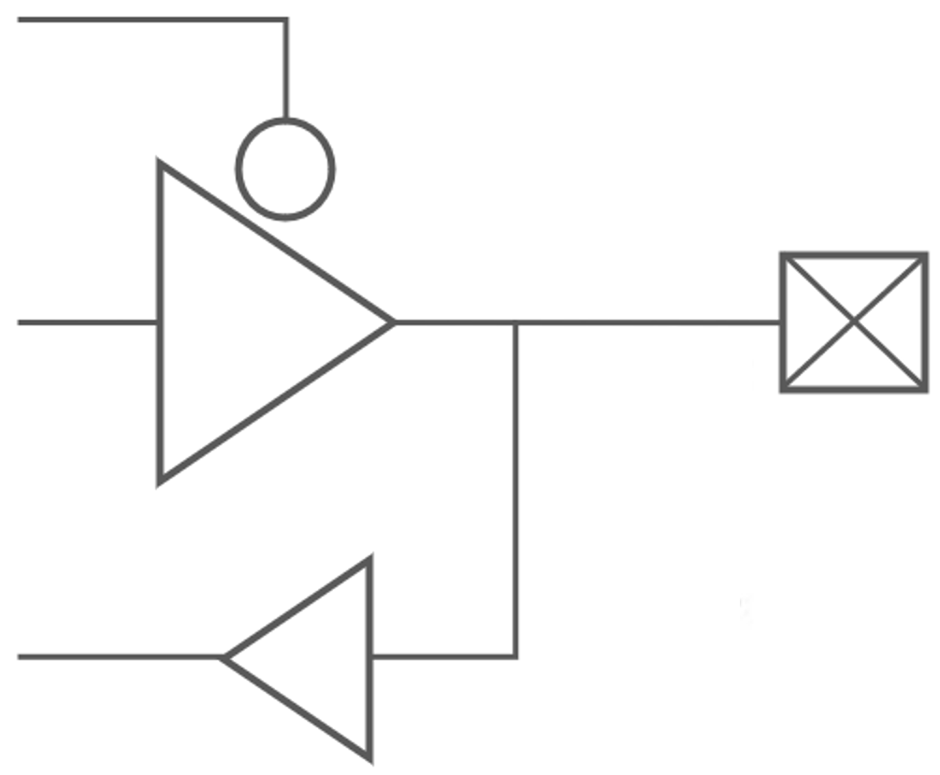
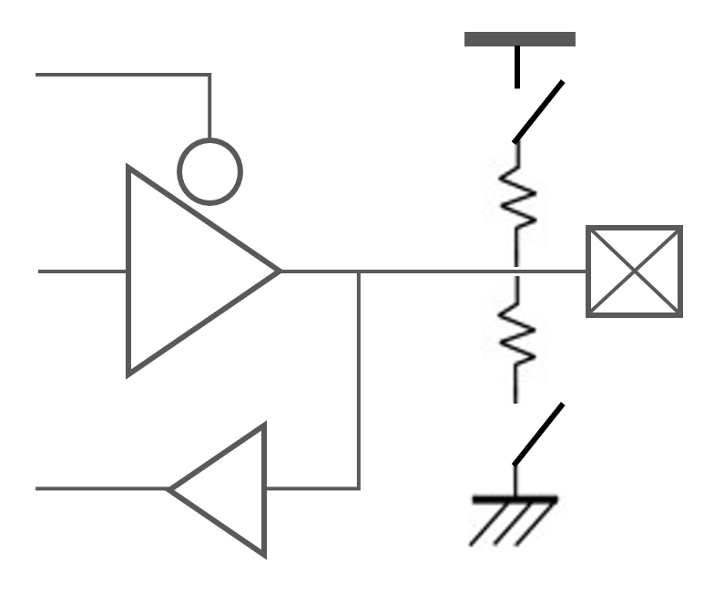
XD12
Equivalent Circuits of individual pins
Pad Name | I/O | Internal Circuit | Description
O1 ~ O12 | Current Sink |  | Current Load
VDD | - |  | Supply voltage
VSS | - |  | GND
FBO/VSI/FBO | I/O |  | 1. FB (daisied) Output (OD) 2. VSYNC (daisied) Input 3. FB Output (Open-drain) ※ if not used, connect to GND
FBI/VSO/VSI | I/O |  | 1. FB (daisied) Input 2. VSYNC (daisied) Output 3. VSYNC Input ※ if not used, connect to GND
V_{DD}
Figure. 4 Equivalent Circuits of individual pins

Slide 7
XD12
Maximum Absolute ratings (Ta = 25℃ unless otherwise noted)
Parameter | Symbol | Value | Unit
Supply voltage | V_{DD} | -0.3 ~ 6.5 | V
Sink output pin voltage | V_{O} | 40 | V
Sink output current | I_{O} | 64 | mA
D_{IO} to GND | V_{DIO} | -0.3 ~ V_{DD}+0.3 | V
D_{DIO} to GND | V_{DDIO} | -0.3 ~ V_{DD}+0.3 | V
Thermal Resistance
Junction to Ambient | R_{θJA} | TBD ¹⁾ | ℃/W
Junction to Case | R_{θJC} | TBD ¹⁾ | ℃/W
Power Dissipation on package | P_{TOT} | TBD ¹⁾ | W
Junction temperature | T_{J} | -20 ~ 150 | ℃
Storage temperature | T_{STG} | -45 ~ 150 | ℃
Relative Humidity (non-condensing) | RH_{NC} | 5 ~ 85 | %
Moisture Sensitivity | MSL | Maximum Floor Life-time | 3
Stresses beyond the Maximum Absolute ratings may cause permanent damage to the device
Note : 1) Surface mounted on FR-4 substrate PC Board 1” x 1” inch 2-oz copper plate
Table 2. Maximum Absolute ratings
Electrostatic Discharge
Parameter | Symbol | Value | Unit | Remark
Electrostatic Discharge HBM ; Contact | ESD_{HBM} | ±2K | V | C=100 pF, R=1.5 kΩ
Electrostatic Discharge CDM ; Contact | ESD_{CDM} | ±500 | V | R=1 Ω
Table 3. Electrostatic Discharge

Slide 8
XD12
Electrical Characteristic (V_{DD} =5.0V, Ta=25.0℃ unless otherwise noted)
Characteristics | Symbol | Condition | Value |  |  | Unit
 |  |  | min | typ | max
Supply voltage
Operating voltage | V_{DD}¹⁾ |  | 4.5 | 5.0 | 5.5 | V
Supply current
Quiescent Current | I_{s} | Standby state, No LED current | - | - | 1.7 | mA
Operating Current 1 | I_{DD1} | All output sink current = 4mA | - | - | 1.8 | mA
Operating Current 2 | I_{DD2} | All output sink current = 8mA | - | - | 2.0 | mA
Operating Current 3 | I_{DD3} | All output sink current = 12mA | - | - | 2.2 | mA
Operating Current 4 | I_{DD4} | All output sink current = 16mA | - | - | 2.4 | mA
Operating Current 5 | I_{DD5} | All output sink current = 24mA | - | - | 2.8 | mA
Operating Current 6 | I_{DD6} | All output sink current = 32mA | - | - | 3.2 | mA
Operating Current 7 | I_{DD7} | All output sink current = 46mA | - | - | 3.8 | mA
Operating Current 8 | I_{DD8} | All output sink current = 64mA | - | - | 4.8 | mA
Oscillator
Internal MCLK | f_{OSC} |  | -3% | 14.746 | +3% | MHz
In/Out
D_{IO}, D_{DIO} | V_{IL} V_{IH} | Input logic low level | - | - | 0.5 | V
 |  | Input logic high level | V_{DD} * 0.8 | - | V_{DD}
 | V_{OL} V_{OH} | Output logic low level | - | - | 0.5 | V
 |  | Output logic high level | V_{DD} * 0.8 | - | V_{DD}
 | R_{PD} | Internal pull-down resistance | - | 48 | - | KΩ
Logic high time ²⁾ | T_{1H}, T_{0L} |  | 6 | - | 20 | MCLK
Logic low time ²⁾ | T_{1L}, T_{0H} |  | 3 | - | 10 | MCLK
Propagation delay | T_{D_DS} | Downstream (D_{IO} to D_{DIO}) | - | 5.0 | 9.0 | ns
Propagation output skew³⁾ | T_{DSKEW_DS} | D_{DDIO} T_{1H}=T_{1H}-T_{DSKEW_DS} @downstrm | - | 1.5 | 2.6 | ns
Propagation delay | T_{D_US} | Upstream (D_{DIO} to D_{IO}) | - | 5.5 | 9.5 | ns
Propagation output skew³⁾ | T_{DSKEW_US} | D_{DIO} T_{1H}=T_{1H}-T_{DSKEW_US} @upstream | - | 1.6 | 2.7 | ns
Logic ‘1’
Logic ‘0’
T_{1H}
T_{0H}
T_{1L}
T_{0L}
Note : 1) The operation below V_{DD}, 5V will limit a maximum LED sinking current and affect a current variation.
2) The conditions, ①T_{1H} ≥ T_{0H}* 2 ② T_{0L} ≥ T_{1L}* 2 ③ (T_{1H} +T_{0H}) = (T_{0L}+T_{1L}) ≤ 95, are recommended.
3) On downstreaming (or upstreaming), the T_{1H} of D_{DDIO} (or T_{1H} of D_{DIO}) is shorted as many as T_{DSKEW_DS} (or
T_{DSKEW_US}), but the total of 1 bit cycle will remain the same. So, the proper value for T_{1H} and T_{0L} must be
carefully determined based on the daisy size.

Slide 9
XD12
Electrical Characteristic (V_{DD} =5.0V, Ta=25.0℃ unless otherwise noted)
Characteristics | Symbol | Condition | Value |  |  | Unit
 |  |  | min | typ | max
Output
Driving voltage | V_{O} | Headroom voltage V_{HD} : 0.60V@ I_{O} 4mA, 0.65V@ I_{O} 8mA 0.70V@ I_{O} 12mA, 0.75V@ I_{O} 16mA 0.80V@ I_{O} 24mA, 0.85V@ I_{O} 32mA 0.90V@ I_{O} 46mA, 0.90V@ I_{O} 64mA | V_{HD} | - | 40 | V
Short detection voltage ⁴⁾ | V_{SD} | Short detection level V_{SD} : 3b’000=3V, 3b’001=4V 3b’010=6V, 3b’011=8V 3b’100=12V, 3b’101=16V 3b’110=24V, 3b’111=36V | V_{SD} | - | - | V
Open detection voltage ⁴⁾ | V_{OD} |  | - | - | 0.25 | V
Sink current | I_{O} | Device max current level : I_{O} 3’b000 = 4mA, 3’b001 = 8mA 3’b010 = 12mA, 3’b011 = 16mA 3’b100 = 24mA, 3’b101 = 32mA 3’b110 = 46mA, 3’b111 = 64mA | - | - | 64 | mA
Current accuracy ⁵⁾ | % | @ IO =Imax(32mA)*0.2 | -3.0 | - | +3.0 | %
 |  | @ IO =Imax(32mA)*0.5 | -2.0 | - | +2.0 | %
 |  | @ IO =Imax(32mA)*1.0 | -2.0 | - | +2.0 | %
LED off current | I_{OFF} | Vo = 40V | - | - | 300 | nA
Feedback
FB threshold voltage (Logically ORed for 12-ch) | V_{FBA} | FB level V_{FBA} : 3’b000 = 0.40V, 3’b001 = 0.50V 3’b010 = 0.60V, 3’b011 = 0.70V 3’b100 = 0.85V, 3’b101 = 1.00V 3’b110 = 1.15V, 3’b111 = 1.30V | - | V_{FBA} | - | V
FB hysteresis voltage | V_{FBH} |  | 40 | 60 | 110 | mV
Thermal protection
Thermal cut off @TJ | TCUT | OFS_TEMP [3:0] = 0x8 | - | 135 | - | ℃
Thermal cut off hysteresis @TJ | THYS |  | 20 | 30 | 40 | ℃
Note : 4) If LED open or short event is happened, the corresponding channel will be turned-off under the function
enabled. If the thermal is happened, all channels output will be turned-off under the function enabled.
5) Under satisfying the power dissipation specification.

Slide 10
XD12
Electrical Characteristic (V_{DD} =5.0V, Ta=25.0℃ unless otherwise noted)
Characteristics | Symbol | Condition | Value |  |  | Unit
 |  |  | min | typ | max
V_{DD} Ramp up and V_{LED} Start
V_{DD} Ramp up time | T_{VDD} | from 0 to stable 5V | - | - | 1.2 | ms
V_{LED} Start time | T_{SU_DIM} | after T_{SU_DIM} is completed | ⁶⁾ | - | - | ms
Initialization after V_{DD}, 5V stable
Internal Initial time | T_{INIT} | from stable 5V | 10 | - | - | ms
Allowed 1st command | T_{FCMD} | after T_{INIT} is completed | 5 | - | - | ms
Timeout : Internal timer starts after completing to receive a read-back command and stops after first response bit from a last daisied device. This depends on the frequency of MCLK.
Internal Timeout ⁷⁾ | T_{TIMEOUT} |  | - | 16,383 | - | MCLK
Note : 6) The time depends on the system configuration, the daisied XD number and Baud-rate.
7) If the timeout will be expired, the internal communication logic will go to an initial state, so new command
transaction will be possible. The timeout function is configurable.
Table 4. Electrical Characteristic
Important statement
Global Technologies reserves the right to change the above-mentioned information without prior notice.
Power Sequence
V_{DD}
5V stable
1st Command to XD
T_{VDD}
T_{INIT}
T_{FCMD}
accessible
Set-up for dimming
XD setup for dimming
V_{LED}
T_{SU_DIM}
Figure 5. Power up sequence and Ramp-up time

Slide 11
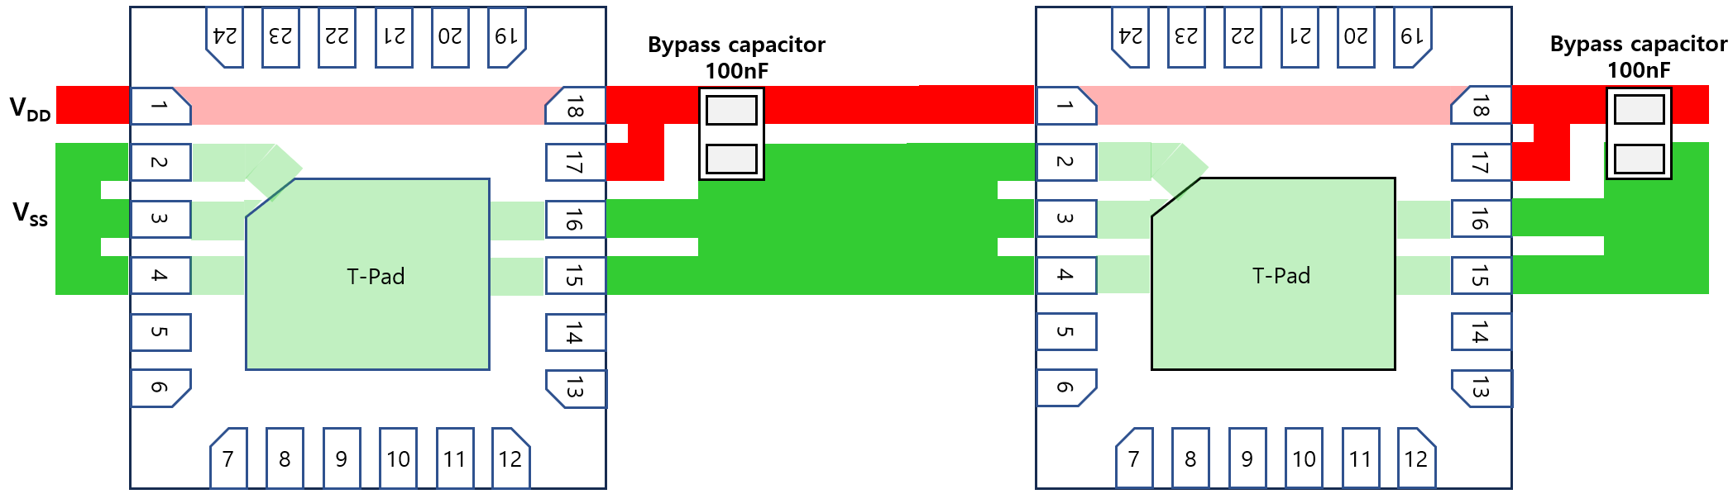
XD12
Layout for Power Lane for single-layer PCB
As shown in the figure below, it is recommended that a bypass capacitor should be placed as close to the pin 18 and 17 as possible in below.

Slide 12
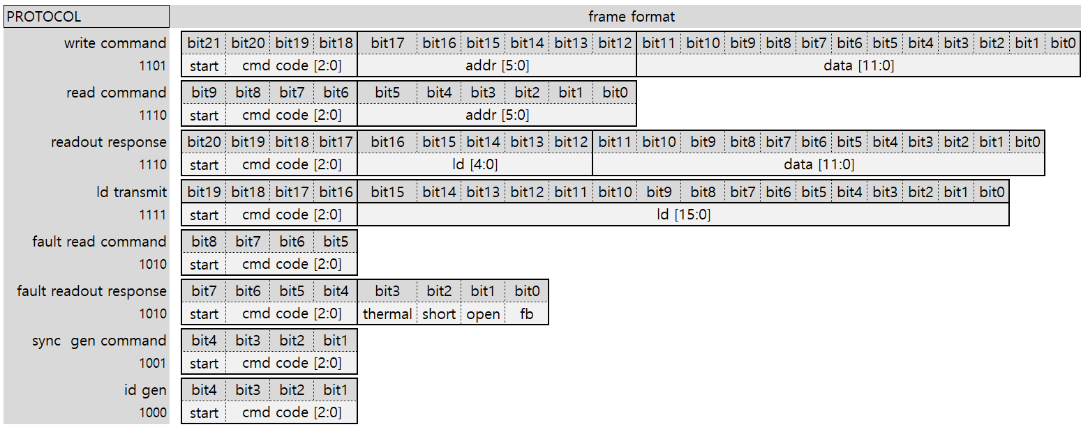
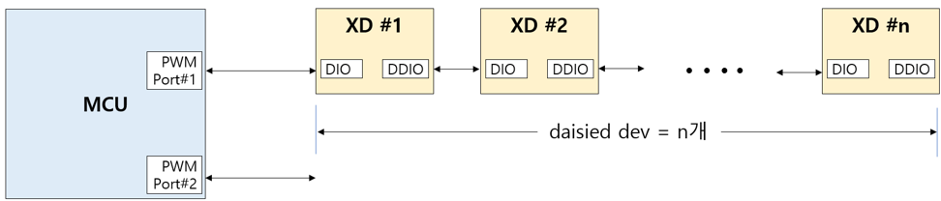
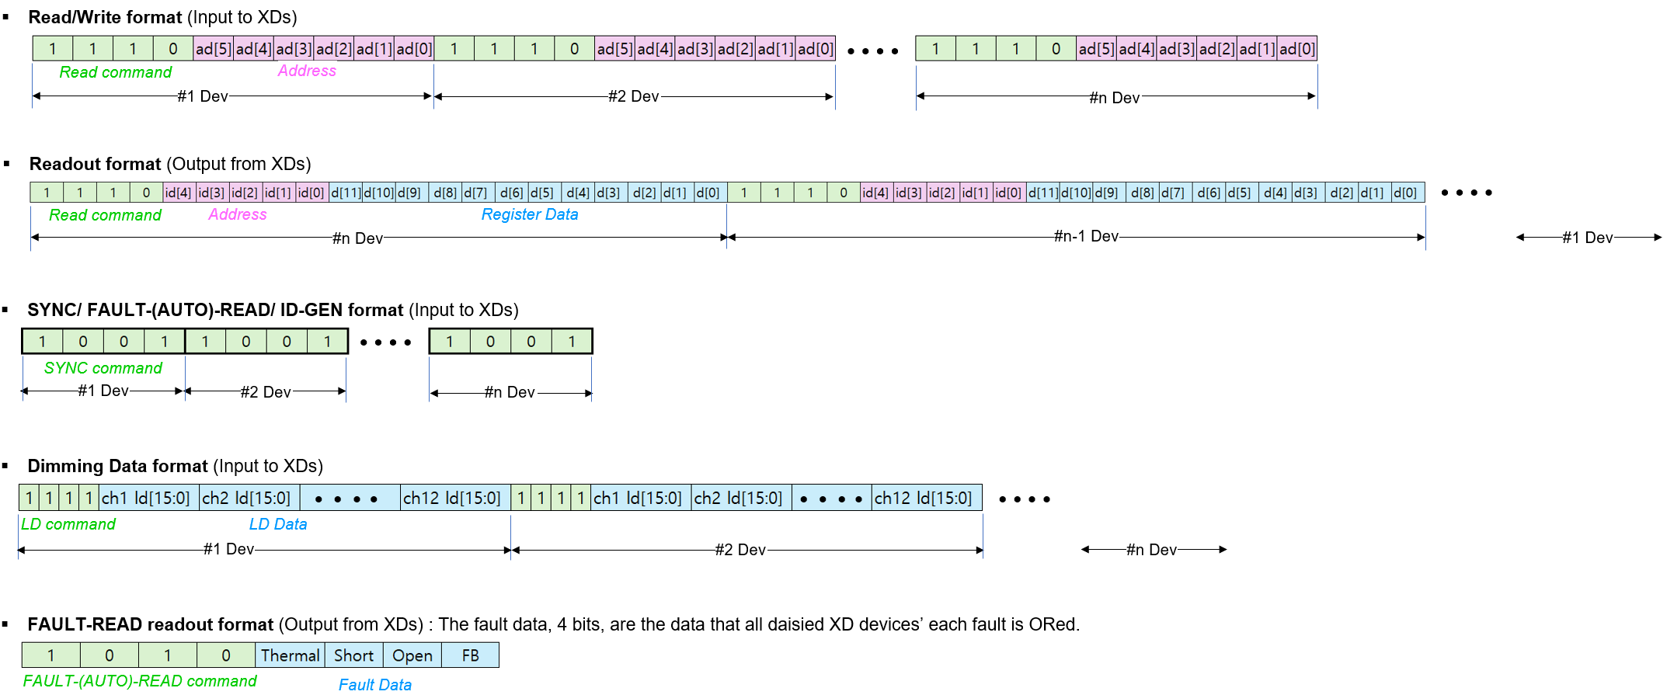
XD12
Functional Description
Serial Communication Protocol
The XD can be controlled with several commands through a XC controller or directly by a Micom. The access protocol and frame format are as follows and if several XD is connected in daisy, the commands should be repeated successively as many as the XD number in daisy chain.
Table 5. Serial communication protocol
The serial communication protocol and the packet formats are shown in below for more details.

Slide 13
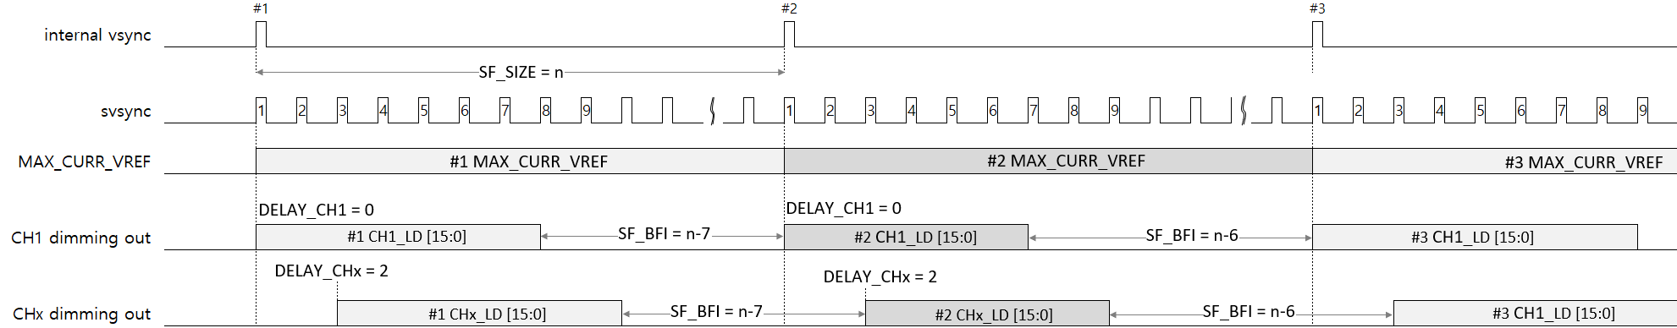
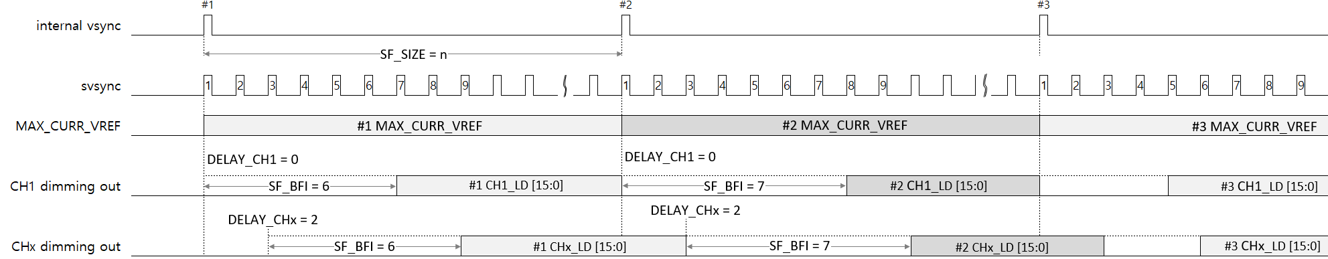
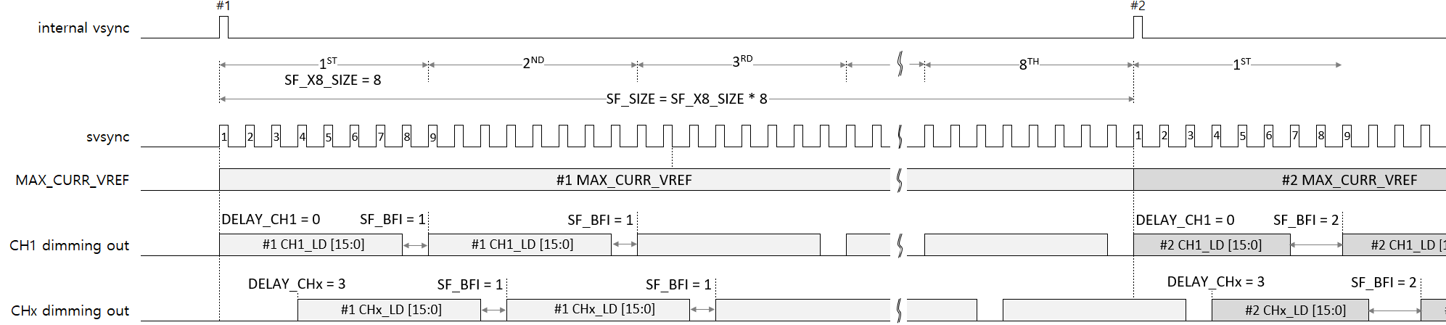
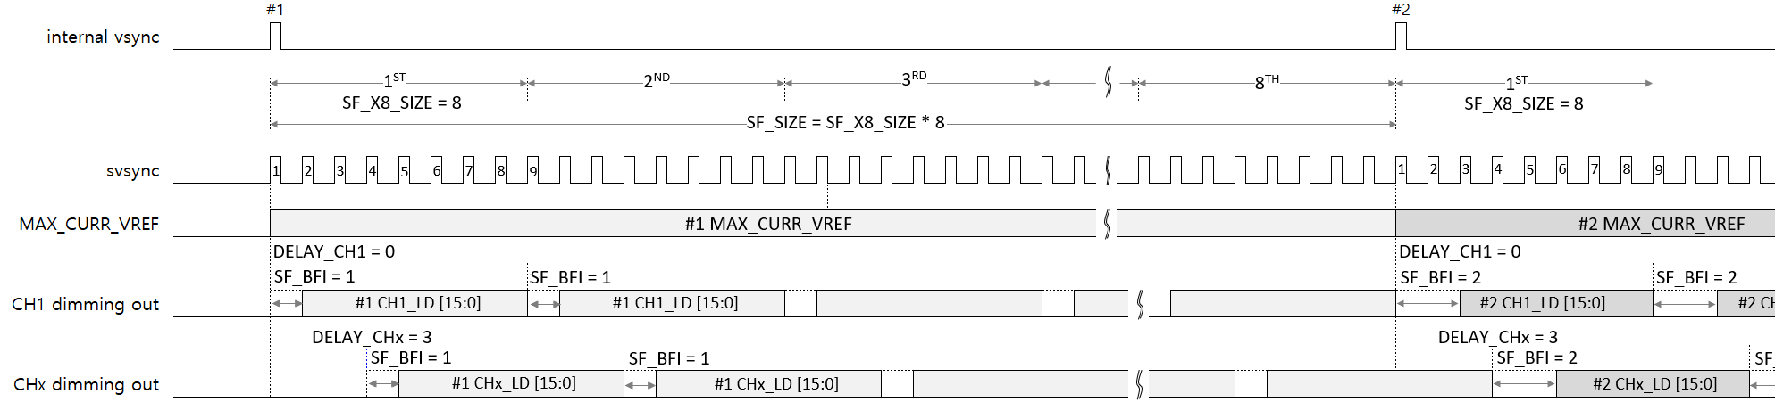
XD12
Functional Description
Dimming in Normal mode
Dimming data
LD_MODE/LD_DIR
MAX_CURR_VREF
SF_PERIOD
SF_BFI_SIZE
These data will be applied at a next vsync after being transmitted
Figure 6. Head lighting
Figure 7. Tail lighting
Dimming in X8 mode
Figure 8. Head lighting
Figure 9. Tail lighting

Slide 14
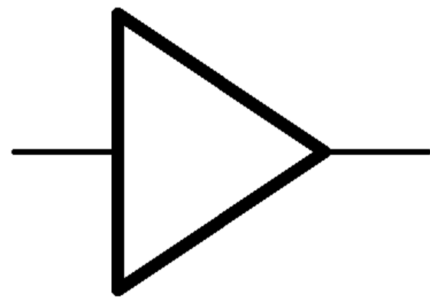

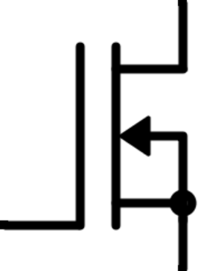
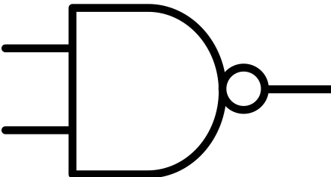

XD12
Functional Description
Optional external VSYNC and FB
The XD has 3 external signal IO modes which can be configured through the IO_MODE bits in the LD MODE register. This function of each mode and the connection scheme is shown as follows.
IO_MODE [1:0] | Description | FBI | FBO | VSI | VSO | Remark
00 | NOP (default) | - | - | - | - | The pins, 5 and 14, can be connected to GND. The FB and VSYNC signal can be replaced by the communication method.
01 | VSYNC daisy mode | - | - | used | used | The FB signal can be replaced by the communication method.
10 | FB daisy mode | used | used | - | - | The VSYNC signal can be replaced by the communication method.
11 | VSYNC and FB non-daisy mode | - | used | - | used | The VSYNC and FB signal can be replaced by the communication method.
XD #n
XD #(n+1)
#n VSI
5
IO_MODE
14
#n VSO
5
IO_MODE
14
#(n+1) VSO
Figure 10. External VSYNC In and Out Scheme
XD #n
XD #(n+1)
#n FBO
5
internal FB
14
#n FBI
5
internal FB
14
#(n+1) FBI
IO_MODE
IO_MODE
Figure 11. External FBI and FBO Scheme
XD
FBO
5
internal FB
14
VSI
IO_MODE
Figure 12. External FBO and VSI Scheme

Slide 15
XD12
Register Map
RESET / ID
Acc | Addr | Default | B11 | B10 | B9 | B8 | B7 | B6 | B5 | B4 | B3 | B2 | B1 | B0
R/W | 0x00 | 0x000 | RST | VS_RST | E_RST | x | x | x | x | ID [4:0]
Bits | Fields |  | Descriptions
11 | RST | 0 1 | NOP All internal logics are initialized to a default state and this bit will be auto-cleared after internal initialization.
0 | VS_RST | 0 1 | NOP If this bit is set, then the serializer and de-serializer of XD will be initialized to a default state at every vsync. This bit set does not affect all internal registers and buffers.
0 | E_RST | 0 1 | NOP If this bit is set, then the serializer and de-serializer of XD will be initialized to a default state at the last to second pwmclk. So, it is careful that the XD access at the back of the frame should be avoided. This bit set does not affect all internal registers and buffers.
4:0 | ID |  | These bits are read only. If the XD12 will receive the ID-Gen command from the XC24 controller, then the ID value is automatically generated. The ID value is needed for proper reading, so, the ID-Gen command must be firstly executed by the XC24 controller before executing any commands. If all XD12 drivers daisied will receive the ID-Gen command, the last-located device will have the first number of ID, and the first located device will have the last number of ID, that is, the number of daisied devices. The ID value can not be written by a Host.

Slide 16
XD12
Register Map
LD MODE
Acc | Addr | Default | B11 | B10 | B9 | B8 | B7 | B6 | B5 | B4 | B3 | B2 | B1 | B0
R/W | 0x01 | 0x000 | x | x | x | x | IO_MODE |  | x | LD_DIR | x | x | x | LD_MODE
Bits | Fields | Descriptions
 |  | This register determines the dimming sequence. Even if the LD_MODE and LD_DIR value will be changed in the middle of current frame, the dimming sequence will keep the current mode to complete the current frame until a next frame start, and then, the new frame according to the changed LD_MODE or LD_DIR will begin dimming at a next SYNC command.
7:6 | IO_MODE | These bits determine the FB and VSYNC functional usage as a pin. Refer to below table.
4 | LD_DIR | This bit determines the direction of modulated edge with increasing on time from a internal vsync. For details, refer to Fig. 6,7,8 and 9. 0 Head Shift Lighting 1 Tail Shift Lighting
0 | LD_MODE | This bit determines the dimming mode, Normal or X8 mode. The Normal mode is for general dimming sequence and the X8 mode is for 8 times repeated dimming sequence in one frame. For details, Fig. 6,7,8 and 9. 0 Normal mode 1 X8 mode
Value | Description | FBI | FBO | VSI | VSO | Remark
00 | NOP (default) | - | - | - | - | VSYNC and FB can be got through a communication. The pins, 5 and 14, can be connected to GND.
01 | VSYNC daisy | - | - | used | used | External VSYNC signal scheme in a daisy FB can be got through a communication.
10 | FB daisy | used | used | - | - | External FB signal scheme in a daisy VSYNC can be got through a communication.
11 | VSYNC and FB non-daisy | - | used | - | used | External VSYNC and FB signal scheme VSYNC and FB can be got through a communication.

Slide 17
XD12
SF PERIOD
Acc | Addr | Default | B11 | B10 | B9 | B8 | B7 | B6 | B5 | B4 | B3 | B2 | B1 | B0
R/W | 0x02 | 0x000 | SF_PERIOD [11:0] |  |  |  |  | DELAY_SIZE [6:0] | x | x | x | x | x | LD_FORCE
Bits | Fields | Descriptions
11:0 | SF_PERIOD | This register determines the length of sub-frame shown in Fig. 6, and if the value will be changed in the middle of a frame, the value will be applied in the next frame. Therefore, this advantage will be useful to switch the frame period during dimming without any flicker. If the value will be increased or decreased gradually to be met the changed frame period,100↔120hz, it results in nearly flicker-less. It needs to be careful to determine the SF_PERIOD that the value should be an integer number after being calculated by a follow formula : SF_PERIOD = (the frame period / SF_SIZE) / MCLK
SF SIZE
Acc | Addr | Default | B11 | B10 | B9 | B8 | B7 | B6 | B5 | B4 | B3 | B2 | B1 | B0
R/W | 0x03 | 0x000 | x | x | x | x | SF_SIZE [7:0]
Bits | Fields | Descriptions
7:0 | SF_SIZE | The SF_SIZE determines the total number of sub-frames in one frame shown in Fig. 6.
CH SIZE / SF X8 SIZE
Acc | Addr | Default | B11 | B10 | B9 | B8 | B7 | B6 | B5 | B4 | B3 | B2 | B1 | B0
R/W | 0x04 | 0x000 | x | LD_SIZE [3:0] |  |  |  | x | x | SF_X8_SIZE [4:0]
Bits | Fields | Descriptions
10:7 | LD_SIZE | This value determines how many LD data will be transmitted for one time. This value is not needed to match with the number of enabled channels in the CHANNEL ENABLE register. It keeps in mind that the LD data to be transmitted will be mapped sequentially from channel 1 to channel n regardless of the corresponded CHx_EN bit activation.
4:0 | SF_X8_SIZE | The SF_X8_SIZE determines the number of sub-frame to be repeated 8 times in a frame, so the set value must be divided the SF_SIZE by 8. For more details, refer to the Fig. 8
SF BFI SIZE
Acc | Addr | Default | B11 | B10 | B9 | B8 | B7 | B6 | B5 | B4 | B3 | B2 | B1 | B0
R/W | 0x05 | 0x000 | x | x | x | x | SF_BFI_SIZE [7:0]
Bits | Fields | Descriptions
7:0 | SF_BFI | The SF_BFI_SIZE determines how many sub-frames are turned-off in a frame. The number should be less than the SF_SIZE in a Normal mode and the SF_X8_SIZE in a X8 mode and can be set to 0 to fully turn-on for a frame time. Even if the value will be changed, the value is kept until completing the current frame, and applied from a next frame. For more details, refer to the Fig. 6,7,8,9 and the number of sub-frame turned-on is as follows : = (SF_SIZE – SF_BFI_SIZE) @ Normal mode = (SF_X8_SIZE – SF_BFI_SIZE) @ X8 mode

Slide 18
XD12
LD FIX1
Acc | Addr | Default | B11 | B10 | B9 | B8 | B7 | B6 | B5 | B4 | B3 | B2 | B1 | B0
R/W | 0x06 | 0xFFF | LD_FIX [11:0] | x | x | x | x | x | x | x | LD_FIX [15:12] | x | x | LD_FORCE
LD FIX 2
Acc | Addr | Default | B11 | B10 | B9 | B8 | B7 | B6 | B5 | B4 | B3 | B2 | B1 | B0
R/W | 0x07 | 0x007 | x | x | x | x | x | x | x | x | LD_FIX [15:12] | x | x | LD_FORCE
Bits | Fields | Descriptions
11:0 3:0 | LD_FIX | The LD_FIX register is used to continuously out a fixed value written in this register instead of LD data to be transmitted form a Host, regardless of the frame sync signal. This function can be used 2 ways, one is for device testing along with the TEST_EN bit and the LD_FIX_EN bit, and the other is for the vsync missing detected. When the vsync missing is detected, then the LD data is out with these registers value.
MAX CURRENT VREF
Acc | Addr | Default | B11 | B10 | B9 | B8 | B7 | B6 | B5 | B4 | B3 | B2 | B1 | B0
R/W | 0x08 | 0x000 | MAX_CURR_VREF [11:0] | x | x | x | x | x | x | x | x | x | RST2 | RST1
Bits | Fields | Descriptions
11:0 | MAX_CURR_VREF | The MAX_CURR_VREF determines the maximum current value of a frame to be dimmed. If the max current level is set to 8mA, then the MAX_CURR_VREF value is proportional to the max current level, and so this value decides the max current reference of all blocks being dimmed for a frame. The set value will come into effect at the next internal vsync assertion even if the value is set during current dimming frame earlier than the next vsync.
CHANNEL ENABLE
Acc | Addr | Default | B11 | B10 | B9 | B8 | B7 | B6 | B5 | B4 | B3 | B2 | B1 | B0
R/W | 0x09 | 0x000 | CH12_EN | CH11_EN | CH10_EN | CH9_EN | CH8_EN | CH7_EN | CH6_EN | CH5_EN | CH4_EN | CH3_EN | CH2_EN | CH1_EN
Bits | Fields | Descriptions
11:0 | CHx_EN | These bits should be set if the corresponding channels are to be used, but can not be set if any channel is not used. The number of enabled channels in these registers does not need to match the LD_SIZE value. It is careful that the number of enabled channels should be the same as the LD_SIZE value, but the number can be smaller than the LD_SIZE value like the special mapping below.
CH1_EN | CH2_EN | CH3_EN | CH4_EN | CH5_EN | CH6_EN | CH7_EN | CH8_EN~CH12_EN
1 | 0 | 1 | 1 | 0 | 1 | 1 | all 0
the number of
enabled channels = 5
the amount of LD data to be transmitted for one time
LD_SIZE = 7
wherein, the LD data of the disabled channels, CH2 and CH5, can be any value

Slide 19
XD12
FAULT STATUS
Acc | Addr | Default | B11 | B10 | B9 | B8 | B7 | B6 | B5 | B4 | B3 | B2 | B1 | B0
RO | 0x0B | 0x000 | MISS_VS | x | OV15 | UV15 | x | x | x | x | THERMAL | SHORT | OPEN | FB
Bits | Fields | Descriptions
11 | MISS_VS | The MISS_VS bit indicates whether the vsync missing event happens, and auto-cleared after readout this register.
9 | OV15 | The OV15 indicates whether the internal LDO keeps over 1.8V for 100us or not, and auto-cleared after a readout this register.
8 | UV15 | The UV15 indicates whether the internal LDO keeps under 1.2V for 100us or not, and auto-cleared after a readout this register.
3 | THERMAL | The THERMAL bit indicates whether the XD12 device has internally a thermal event from overheating due to high current for a long time. This bit will keep asserted as long as the internal THERMAL event is not cleared. The THERMAL threshold can be set by the OFS_TEMP of the LD CONTROL register. If the T_OFF_E bit of the FAULT MODE register is set, all output sink drivers will be turned-off under the THERMAL bit is set until the internal temperature goes down below the set level of the OFS_TEMP. This bit involves other fault events in the readout information, MISS_VS,OV15 and UV15 at the FAULT_(AUTO)_READ transaction.
2 | SHORT | The SHORT bit indicates whether the XD12 output pin is short to a VLED line due to any soldering condition. The detection condition can be set by the SHORT_LEVEL of the FAULT LEVEL register and the SHORT ENABLE LEVEL register. This bit is set when the SHORT_DEC_EN1/2 bit is set and the SHORT event occurs in even one of the activated channels, and then, will be auto-cleared after readout this register, but the bit will be set again as long as the SHORT event is still valid. If the S_OFF_E bit of the FAULT MODE register is set, the corresponding output sink driver will be turned-off under this bit is set until the event is cleared.
1 | OPEN | The OPEN bit indicates whether the XD12 output pin is open in spite of being activated. The open level is fixed to 0.25V. This bit is set when the OPEN_DEC_EN bit is set and the OPEN event occurs in even one of the activated channels and then, will be auto-cleared after readout this register, but the bit will be set again as long as the OPEN event is still valid. If the O_OFF_E bit of the FAULT MODE register is set, the corresponding output sink driver will be turned-off under this bit is set until the event is cleared. It needs to follow below to determine the validity of the OPEN event. * in case that the OPEN and FB are simultaneously-asserted even if the LD data are all 0 * in case that the OPEN and FB are simultaneously-asserted even if the VLED remains at the max level for a long time.
0 | FB | The FB bit indicates whether the XD12 output pin’s headroom voltage is below the value set by FB_LEVEL of the FAULT LEVEL register. This bit is set when a FB event occurs in even one of the activated channels and then, will be auto-cleared after readout this register. This bit will be set again after readout as long as the FB event is still valid.

Slide 20
XD12
FAULT LEVEL
Acc | Addr | Default | B11 | B10 | B9 | B8 | B7 | B6 | B5 | B4 | B3 | B2 | B1 | B0
R/W | 0x0C | 0x000 | x | DEV_MAX_CURR_LEVEL [2:0] | x | x | x | SHORT_LEVEL [2:0] | x | x | x | FB_LEVEL [2:0] | FB_LEVEL [1:0]
Bits | Fields | Descriptions
10:8 | DEV_MAX_CURR_ LEVEL | The DEV_MAX_CURR_LEVEL determines the physical maximum current level of the device. The max dimming sink-current set by the MAX_CURR_VREF can not be beyond the DEV_MAX_CURR_LEVEL. 3b’000 : max 4mA 3b’011 : max 16mA 3b’110 : max 46mA 3b’001 : max 8mA 3b’100 : max 24mA 3b’111 : max 64mA 3b’010 : max 12mA 3b’101 : max 32mA
6:4 | SHORT_LEVEL | The SHORT_LEVEL determines the level at which a SHORT event occurs. 3b’000 : above 3V 3b’011 : above 8V 3b’110 : above 24V 3b’001 : above 4V 3b’100 : above 12V 3b’111 : above 36V 3b’010 : above 6V 3b’101 : above 16V
2:0 | FB_LEVEL | The FB_LEVEL determines the level at which a FB event occurs. 3b’000 : below 0.40V 3b’011 : below 0.70V 3b’110 : below 1.15V 3b’001 : below 0.50V 3b’100 : below 0.85V 3b’111 : below 1.30V 3b’010 : below 0.60V 3b’101 : below 1.00V

Slide 21
XD12
FAULT CONTROL
Acc | Addr | Default | B11 | B10 | B9 | B8 | B7 | B6 | B5 | B4 | B3 | B2 | B1 | B0
R/W | 0x0D | 0x800 | TIMEOUT_EN | OVUV15_EN | x | x | MISS_VS_DIMM | MISS_VS_DET_E | O_EN | S2_EN | S1_EN | T_OFF_EN | S_OFF_EN | O_OFF_EN
Bits | Fields |  | Descriptions
11 | TIMEOUT_EN |  | If this bit is set, the internal timeout timer starts counting after some read-back command stream is done and stops after the XD responds own information to the front XD. If the timer will be expired due to any no response, internal communication logics will be recovered to the standby state. The timeout counter is expired at approximately 2.1ms upon receiving the read command. Recommended to be set.
10 | OVUV15_EN |  | This enables the detection of OV15 and UV15 of the internal LDO output.
7 | MISS_VS_DIMM |  | Under the MS_VS_DIMM = 1 and the MS_VS_DET_E = 1, if the vsync missing event happens, then the dimming will be automatically fixed to the LD FIX 1/2 and the VREF FIX value until receiving a vsync.
6 | MISS_VS_DET_E |  | This bit enables to detect whether the vsync input is missed or not. If the vsync is not supplied within about 35ms, then the vsync missing event is asserted internally. This event assertion can be readout through the FALUT STATUS register.
5 | OPEN_DET_EN |  | This bit enable the LED OPEN detection that can work under only the LD data are all zeros. In case that the LD data are all zero and the output headroom goes below 0.25V, then the OPEN event will be asserted.
4 | SHORT_DET_EN2 |  | This bit enables the LED SHORT detection that can work under only the LD data’s MSB 5 bits are not all zeros. In case that MSB 4 bits are not all zeros and the SHORT_LEVEL is set to 3V, the SHORT event will be asserted if the corresponding channel’s headroom goes above 3V.
3 | SHORT_DET_EN1 |  | This bit enables the LED SHORT detection that can work under only the LD data’s MSB 4 bits are not all zeros. In case that MSB 4 bits are not all zeros and the SHORT_LEVEL is set to 3V, the SHORT event will be asserted if the corresponding channel’s headroom goes above 3V.
2 | T_OFF_EN |  | In case of this bit = 0, even if the THERMAL event happens, all channels’ output will be not off, but the flag can be visible through the FAULT STATUS register. In case of this bit = 1, if the THERMAL event happens, all channels’ output will be off, and the flag can be visible through the FAULT STATUS register. It is recommended to be set for a safety and for the operating condition, refer to the Electrical characteristics.
1 | S_OFF_EN |  | In case of this bit = 0, even if the LED SHORT event happens, the corresponding channel output will be not off, but the flag can be visible through the FAULT STATUS register. In case of this bit = 1, if the LED SHORT event happens, the corresponding channel output will be off, and the flag can be visible through the FAULT STATUS register. The LED short detection condition can be configurable through the SHORT_LEVEL, the S1_EN bit and S2_EN bit is set. It is recommended to be set for a safe operation.
0 | O_OFF_EN |  | In case of this bit = 0, even if the LED OPEN event happens, the corresponding channel output will be not off, but the flag can be visible through the FAULT STATUS register. In case of this bit = 1, if the LED OPEN event happens, the corresponding channel output will be off, and the flag can be visible through the FAULT STATUS register. The LED OPEN event can be detected if the channel headroom goes down below 0.25V.

Slide 22
XD12
DELAY_CH1
Acc | Addr | Default | B11 | B10 | B9 | B8 | B7 | B6 | B5 | B4 | B3 | B2 | B1 | B0
R/W | 0x0E | 0x000 | x | x | x | x | DELAY_CH1 [7:0] | x | x | x | x | x | x | x
DELAY_CH2
Acc | Addr | Default | B11 | B10 | B9 | B8 | B7 | B6 | B5 | B4 | B3 | B2 | B1 | B0
R/W | 0x0F | 0x000 | x | x | x | x | DELAY_CH2 [7:0] | x | x | x | x | x | x | x
DELAY_CH3
Acc | Addr | Default | B11 | B10 | B9 | B8 | B7 | B6 | B5 | B4 | B3 | B2 | B1 | B0
R/W | 0x10 | 0x000 | x | x | x | x | DELAY_CH3 [7:0] | x | x | x | x | x | x | x
DELAY_CH4
Acc | Addr | Default | B11 | B10 | B9 | B8 | B7 | B6 | B5 | B4 | B3 | B2 | B1 | B0
R/W | 0x11 | 0x000 | x | x | x | x | DELAY_CH4 [7:0] | x | x | x | x | x | x | x
DELAY_CH5
Acc | Addr | Default | B11 | B10 | B9 | B8 | B7 | B6 | B5 | B4 | B3 | B2 | B1 | B0
R/W | 0x12 | 0x000 | x | x | x | x | DELAY_CH5 [7:0] | x | x | x | x | x | x | x
DELAY_CH6
Acc | Addr | Default | B11 | B10 | B9 | B8 | B7 | B6 | B5 | B4 | B3 | B2 | B1 | B0
R/W | 0x13 | 0x000 | x | x | x | x | DELAY_CH6 [7:0] | x | x | x | x | x | x | x
DELAY_CH7
Acc | Addr | Default | B11 | B10 | B9 | B8 | B7 | B6 | B5 | B4 | B3 | B2 | B1 | B0
R/W | 0x14 | 0x000 | x | x | x | x | DELAY_CH7 [7:0] | x | x | x | x | x | x | x
DELAY_CH8
Acc | Addr | Default | B11 | B10 | B9 | B8 | B7 | B6 | B5 | B4 | B3 | B2 | B1 | B0
R/W | 0x15 | 0x000 | x | x | x | x | DELAY_CH8 [7:0] | x | x | x | x | x | x | x
DELAY_CH9
Acc | Addr | Default | B11 | B10 | B9 | B8 | B7 | B6 | B5 | B4 | B3 | B2 | B1 | B0
R/W | 0x16 | 0x000 | x | x | x | x | DELAY_CH9 [7:0] | x | x | x | x | x | x | x
DELAY_CH10
Acc | Addr | Default | B11 | B10 | B9 | B8 | B7 | B6 | B5 | B4 | B3 | B2 | B1 | B0
R/W | 0x17 | 0x000 | x | x | x | x | DELAY_CH10 [7:0] | x | x | x | x | x | x | x

Slide 23
XD12
DELAY_CH11
Acc | Addr | Default | B11 | B10 | B9 | B8 | B7 | B6 | B5 | B4 | B3 | B2 | B1 | B0
R/W | 0x18 | 0x000 | x | x | x | x | DELAY_CH11 [7:0] | x | x | x | x | x | x | x
DELAY_CH12
Acc | Addr | Default | B11 | B10 | B9 | B8 | B7 | B6 | B5 | B4 | B3 | B2 | B1 | B0
R/W | 0x19 | 0x000 | x | x | x | x | DELAY_CH12 [7:0] | x | x | x | x | x | x | x
Bits | Fields | Descriptions
7:0 | DELAY_CHx | The DELAY_CHx determines from which sub-frame to start dimming out. If this is set to n, then the dimming out starts at (n+1)^{th} sub-vsync. Normally, the value can not exceed the (SF_SIZE-1) value. For more details, refer to the Figure. 6,7,8,9.
WR PROTECT
Acc | Addr | Default | B11 | B10 | B9 | B8 | B7 | B6 | B5 | B4 | B3 | B2 | B1 | B0
RO | 0x25 | 0x155 | x | x | REG_WR_PROTECT [9:0]
Bits | Fields | Descriptions
9:0 | REG_WR_PROTECT | This feature is used to protect write access to all internal registers except the MAX_ CURR_REF register. The set value, 0x155, means that the write access to all internal registers is allowable. The set value, 0x2AA, means that the write access to all internal registers except the MAX_CURR_REF register is not allowable.

Slide 24
XD12
SERIALIZER OUTPUT BAUDRATE
Acc | Addr | Default | B11 | B10 | B9 | B8 | B7 | B6 | B5 | B4 | B3 | B2 | B1 | B0
R/W | 0x26 | 0x1CE | SERIAL_CLK_LOW [5:0] |  |  |  |  |  | SERIAL_CLK_HIGH [5:0] |  |  | x | x | x
Bits | Fields | Descriptions
11:6 | SERIAL_CLK_LOW | These bits determine the number of MCLK of V_{DD} level in logic low value ‘0’ or the number of MCLK of 0 level in logic high value ‘1’ when the XD12 is driving the D_{IO} pin on read-back. For more details, refer to Table. 4, Logic low time.
5:0 | SERIAL_CLK_HIGH | These bits determine the number of MCLK of V_{DD} level in logic high value ‘1’ or the number of MCLK of 0 level in logic low value ‘0’ when the XD12 is driving the D_{IO} pin on read-back. For more details, refer to Table. 4, Logic high time.
SERIAL_LATENCY
Acc | Addr | Default | B11 | B10 | B9 | B8 | B7 | B6 | B5 | B4 | B3 | B2 | B1 | B0
R/W | 0x27 | 0x050 | x | x | x | x | x | SERIAL_LATENCY [6:0]
Bits | Fields | Descriptions
6:0 | SERIAL_LATENCY | This determines the interval time between the successive data packets incoming from the XC. That means the interval time between the last bit of n^{th} XD device’s data packet and the first bit of (n+1)^{th} XD device’s data packet incoming from the XC. The setting value should be larger than the 1-bit serial data length time at which the XC is sending to the daisied XDs. So, the proper value depends on the serial baudrate of the XC and can be set between (1-bit time + 3 MCLKs) and (1-bit time + 5 MCLKs). If the proper value will be set, then the serial data value will be broken.

Slide 25
XD12
DCLK PERIOD
Acc | Addr | Default | B11 | B10 | B9 | B8 | B7 | B6 | B5 | B4 | B3 | B2 | B1 | B0
R/W | 0x28 | 0x000 | DCLK_RST_E | x | DCLK_PERIOD [9:0] |  |  |  |  |  |  | x | x | x
Bits | Fields | Descriptions
11 | DCLK_RST_E | If this bit is set, the DCLK_PERIOD counter will be reset at every internal vsync. It is recommended to be set for expressing precise gradation at every frame sync.
9:0 | DCLK_PERIOD | An integer multiple of the DCLK_PERIOD must be equal to the SF_PERIOD. It is recommended to be set from 64 to 128 but depends on the system performance. Even if the SF_PERIOD value becomes different according to the frame period, it is better to select a value among 64 ~ 128 that can meet an integer multiple of the SF_PERIOD.
MCLK LOCK
Acc | Addr | Default | B11 | B10 | B9 | B8 | B7 | B6 | B5 | B4 | B3 | B2 | B1 | B0
R/W | 0x29 | 0x000 | MCLK_LOCK [11:0]
Acc | Addr | Default | B11 | B10 | B9 | B8 | B7 | B6 | B5 | B4 | B3 | B2 | B1 | B0
R/W | 0x2A | 0x01E | MCLK_LOCK_E | x | x | x | MCLK_LOCK [19:12]
Bits | Fields | Descriptions
11 | MCLK_LOCK_E | The MCLK LOCK function is used to calibrate the internal oscillator (=MCLK) to a target frequency owing to the temperature variation in a real-time, but for use, the exact period of SYNC commands must be continuously supplied to a XD. It should be careful that this bit must be cleared to 0 when changing the frame period, 100↔120hz, or free-sync mode especially. This bit should only be used when the SYNC command intervals are regular. This bit value will be refreshed with a written value at every internal vsync signal. 0 MCLK_LOCK function disabled 1 MCLK_LOCK function enabled
19:0 | MCLK_LOCK | The value determines the number of MCLKs between the SYNC commands. = SYNC command period (=frame period) / MCLK
OSC COMPENSATION
Acc | Addr | Default | B11 | B10 | B9 | B8 | B7 | B6 | B5 | B4 | B3 | B2 | B1 | B0
R/W | 0x2B | 0x00F | OSC_POL | x | x | x | x | x | x | OSC_COMP [4:0]
Bits | Fields | Descriptions
11 | OSC_POL | The compensation polarity 0 Positive characteristics 1 Negative characteristics
4:0 | OSC_COMP | This register is containing the current compensated value during MCLK_LOCK_E=1, and the value will be kept even if the MCLK_LOCK_E becomes disabled. If this register will be written to some value in the middle of working, the compensating start newly from the written value.

Slide 26
XD12
OSC COMPENSATION THRESHOLD POSITIVE / NEGATIVE
Acc | Addr | Default | B11 | B10 | B9 | B8 | B7 | B6 | B5 | B4 | B3 | B2 | B1 | B0
R/W | 0x2C | 0x080 | x | OSC_COMP_TH_P [10:0]
Acc | Addr | Default | B11 | B10 | B9 | B8 | B7 | B6 | B5 | B4 | B3 | B2 | B1 | B0
R/W | 0x2D | 0x200 | x | OSC_COMP_TH_N [10:0]
Bits | Fields | Descriptions
10:0 | OSC_COMP_TH_P OSC_COMP_TH_N | This value means the threshold that determines what to do with the compensation. The MCLK will be faster or slower 80khz per 184. Normally, it is recommended to use the default value. 1. In case of MCLK_LOCK > internal mclk counting value : if the difference > OSC_COMP_TH_P, then increase OSC_COMP by 1 and result in MCLK faster 2. In case of MCLK_LOCK < internal mclk counting value : if the difference > OSC_COMP_TH_N, then decrease OSC_COMP by 1 and result in MCLK slower 3. Else : keep the current state 4. The signs in the above equation, + and -, is exchanged each other if the OSC_POL is set.
LD CONTROL
Acc | Addr | Default | B11 | B10 | B9 | B8 | B7 | B6 | B5 | B4 | B3 | B2 | B1 | B0
R/W | 0x2E | 0x840 | OFS_TEMP[3:0] |  |  |  | x | ICTL_GLB[2:0] |  |  | x | x | x | x
Bits | Fields | Descriptions
 |  | It is recommended to use the default value
VREF FIX
Acc | Addr | Default | B11 | B10 | B9 | B8 | B7 | B6 | B5 | B4 | B3 | B2 | B1 | B0
R/W | 0x2F | 0x000 | VREF_FIX [11:0]
Bits | Fields | Descriptions
11:0 | VREF_FIX | It determines the fixed VREF out value instead of the MAX_CURR_VREF when the vsync miss is detected under the MISS_VS_DIMM=1 and the MISS_VS_DET_E=1. At the same time, the LD data is out with the LD FIX registers value.

Slide 27
XD12
These registers can not go outside the Global Technologies.
OP MODE
Acc | Addr | Default | B11 | B10 | B9 | B8 | B7 | B6 | B5 | B4 | B3 | B2 | B1 | B0
R/W | 0x3F | 0x000 | TEST_EN | DDIO_DIS | TEST_ANA_EN [1:0] |  | LD_FIX_EN | x | MCLK16_O | x | x | x | x | ADDR_EXT
Bits | Fields |  | Descriptions
11 | TEST_EN | 0 1 | NOP For testing, there are two purposes for use as follows : a. The MCLK divided by 16 is output to the D_{DIO} pin for trimming the internal OSC. b. Specially used with the LD_FIX_EN bit.
10 | DDIO_DIS | 0 1 | NOP Under TEST_EN=1, the D_{DIO} pin’s output will be disabled so that the read access of registers is possible without any mulfunction even though the MCLK16 clock is driven on the D_{DIO} pin.
9:8 | TEST_ANA_EN
7 | LD_FIX_EN | 0 1 | NOP For testing, there are two purposes for use with the TEST_EN bit=1 as follows : a. The MAX_CURR_VREF reg value is continuously out to a current control logics. b. The LD_FIX value is continuously out to a current control logics without sync signals.
5 | MCLK16_O | 0 1 | NOP Under TEST_EN =1, the clock obtained by dividing MCLK by 16 is output to DDIO pin.
0 | ADDR_EXT | 0 1 | This bit is used to select which register group, the general registers or the OTP mirror registers, will be accessed. The OTP control registers address, 0x3A ~ 0x3F, can be commonly accessed regardless of this bit. The general registers can be accessed except for the OTP mirror registers. The OTP mirror registers can be accessed except for the general registers.

Slide 28
XD12
These registers can not go outside the Global Technologies.
OTP ACCESS
Acc | Addr | Default | B11 | B10 | B9 | B8 | B7 | B6 | B5 | B4 | B3 | B2 | B1 | B0
R/W | 0x3A | 0x000 | x | x | x | x | x | x | x | x | OTP_PG_ACCESS_CYCLE [15:12] | x | x
Acc | Addr | Default | B11 | B10 | B9 | B8 | B7 | B6 | B5 | B4 | B3 | B2 | B1 | B0
R/W | 0x3B | 0x140 | OTP_PG_ACCESS_CYCLE [11:0] | x | x | x | x | x | x | I_{D} [4:0] | x | x | RST2 | RST1
OTP WRITE
Acc | Addr | Default | B11 | B10 | B9 | B8 | B7 | B6 | B5 | B4 | B3 | B2 | B1 | B0
R/W | 0x3C | 0x004 | x | x | x | x | x | x | x | x | OTP_WSEL [3:0] | SHORT | OPEN | FB
OTP RD/PROG
Acc | Addr | Default | B11 | B10 | B9 | B8 | B7 | B6 | B5 | B4 | B3 | B2 | B1 | B0
R/W | 0x3D | 0x000 | x | x | x | x | x | x | x | x | x | x | OTP_RD_START | OTP_PG_START
OTP PROTECT
Acc | Addr | Default | B11 | B10 | B9 | B8 | B7 | B6 | B5 | B4 | B3 | B2 | B1 | B0
R/W | 0x3E | 0x5A5 | PROTECT_EN/DIS [11:0] ※ enable (0x5A5), disable (0xA5A), need to disable for writing | x | x | x | x | x | x | I_{D} [4:0] | x | x | RST2 | RST1
These registers are the OTP Mirror registers.
OTP CRC
Acc | Addr | Default | B11 | B10 | B9 | B8 | B7 | B6 | B5 | B4 | B3 | B2 | B1 | B0
R/W | 0x00 | 0x000 | x | x | x | x | OTP_CRC_CHECKSUM [7:0] | x | x | x | x | x | x | x
OSC
Acc | Addr | Default | B11 | B10 | B9 | B8 | B7 | B6 | B5 | B4 | B3 | B2 | B1 | B0
R/W | 0x01 | 0x040 | x | x | x | x | x | OSC [6:0] | x | x | x | x
VREF CTL
Acc | Addr | Default | B11 | B10 | B9 | B8 | B7 | B6 | B5 | B4 | B3 | B2 | B1 | B0
R/W | 0x02 | 0x020 | x | x | x | x | x | x | VREF_CTL [5:0] |  | x | x

Slide 29
XD12
These registers can not go outside the Global Technologies.
OFS 1
Acc | Addr | Default | B11 | B10 | B9 | B8 | B7 | B6 | B5 | B4 | B3 | B2 | B1 | B0
R/W | 0x03 | 0x040 | x | x | x | x | x | OFS_CH1 [6:0] | x | x | x | x
OFS 2
Acc | Addr | Default | B11 | B10 | B9 | B8 | B7 | B6 | B5 | B4 | B3 | B2 | B1 | B0
R/W | 0x04 | 0x040 | x | x | x | x | x | OFS_CH2 [6:0] | x | x | x | x
OFS 3
Acc | Addr | Default | B11 | B10 | B9 | B8 | B7 | B6 | B5 | B4 | B3 | B2 | B1 | B0
R/W | 0x05 | 0x040 | x | x | x | x | x | OFS_CH3 [6:0] | x | x | x | x
OFS 4
Acc | Addr | Default | B11 | B10 | B9 | B8 | B7 | B6 | B5 | B4 | B3 | B2 | B1 | B0
R/W | 0x06 | 0x040 | x | x | x | x | x | OFS_CH4 [6:0] | x | x | x | x
OFS 5
Acc | Addr | Default | B11 | B10 | B9 | B8 | B7 | B6 | B5 | B4 | B3 | B2 | B1 | B0
R/W | 0x07 | 0x040 | x | x | x | x | x | OFS_CH5 [6:0] | x | x | x | x
OFS 6
Acc | Addr | Default | B11 | B10 | B9 | B8 | B7 | B6 | B5 | B4 | B3 | B2 | B1 | B0
R/W | 0x08 | 0x040 | x | x | x | x | x | OFS_CH6 [6:0] | x | x | x | x
OFS 7
Acc | Addr | Default | B11 | B10 | B9 | B8 | B7 | B6 | B5 | B4 | B3 | B2 | B1 | B0
R/W | 0x09 | 0x040 | x | x | x | x | x | OFS_CH7 [6:0] | x | x | x | x
OFS 8
Acc | Addr | Default | B11 | B10 | B9 | B8 | B7 | B6 | B5 | B4 | B3 | B2 | B1 | B0
R/W | 0x0A | 0x040 | x | x | x | x | x | OFS_CH8 [6:0] | x | x | x | x
OFS 9
Acc | Addr | Default | B11 | B10 | B9 | B8 | B7 | B6 | B5 | B4 | B3 | B2 | B1 | B0
R/W | 0x0B | 0x040 | x | x | x | x | x | OFS_CH9 [6:0] | x | x | x | x
OFS 10
Acc | Addr | Default | B11 | B10 | B9 | B8 | B7 | B6 | B5 | B4 | B3 | B2 | B1 | B0
R/W | 0x0C | 0x040 | x | x | x | x | x | OFS_CH10 [6:0] | x | x | x | x
OFS 11
Acc | Addr | Default | B11 | B10 | B9 | B8 | B7 | B6 | B5 | B4 | B3 | B2 | B1 | B0
R/W | 0x0D | 0x040 | x | x | x | x | x | OFS_CH11 [6:0] | x | x | x | x
OFS 12
Acc | Addr | Default | B11 | B10 | B9 | B8 | B7 | B6 | B5 | B4 | B3 | B2 | B1 | B0
R/W | 0x0E | 0x040 | x | x | x | x | x | OFS_CH12 [6:0] | x | x | x | x

Slide 30
XD12
These registers can not go outside the Global Technologies.
GAIN 1
Acc | Addr | Default | B11 | B10 | B9 | B8 | B7 | B6 | B5 | B4 | B3 | B2 | B1 | B0
R/W | 0x1B | 0x040 | x | x | x | x | x | GAIN_CH1 [6:0] | x | x | x | x
GAIN 2
Acc | Addr | Default | B11 | B10 | B9 | B8 | B7 | B6 | B5 | B4 | B3 | B2 | B1 | B0
R/W | 0x1C | 0x040 | x | x | x | x | x | GAIN_CH2 [6:0] | x | x | x | x
GAIN 3
Acc | Addr | Default | B11 | B10 | B9 | B8 | B7 | B6 | B5 | B4 | B3 | B2 | B1 | B0
R/W | 0x1D | 0x040 | x | x | x | x | x | GAIN_CH3 [6:0] | x | x | x | x
GAIN 4
Acc | Addr | Default | B11 | B10 | B9 | B8 | B7 | B6 | B5 | B4 | B3 | B2 | B1 | B0
R/W | 0x1E | 0x040 | x | x | x | x | x | GAIN_CH4 [6:0] | x | x | x | x
GAIN 5
Acc | Addr | Default | B11 | B10 | B9 | B8 | B7 | B6 | B5 | B4 | B3 | B2 | B1 | B0
R/W | 0x1F | 0x040 | x | x | x | x | x | GAIN_CH5 [6:0] | x | x | x | x
GAIN 6
Acc | Addr | Default | B11 | B10 | B9 | B8 | B7 | B6 | B5 | B4 | B3 | B2 | B1 | B0
R/W | 0x20 | 0x040 | x | x | x | x | x | GAIN_CH6 [6:0] | x | x | x | x
GAIN 7
Acc | Addr | Default | B11 | B10 | B9 | B8 | B7 | B6 | B5 | B4 | B3 | B2 | B1 | B0
R/W | 0x21 | 0x040 | x | x | x | x | x | GAIN_CH7 [6:0] | x | x | x | x
GAIN 8
Acc | Addr | Default | B11 | B10 | B9 | B8 | B7 | B6 | B5 | B4 | B3 | B2 | B1 | B0
R/W | 0x22 | 0x040 | x | x | x | x | x | GAIN_CH8 [6:0] | x | x | x | x
GAIN 9
Acc | Addr | Default | B11 | B10 | B9 | B8 | B7 | B6 | B5 | B4 | B3 | B2 | B1 | B0
R/W | 0x23 | 0x040 | x | x | x | x | x | GAIN_CH9 [6:0] | x | x | x | x
GAIN 10
Acc | Addr | Default | B11 | B10 | B9 | B8 | B7 | B6 | B5 | B4 | B3 | B2 | B1 | B0
R/W | 0x24 | 0x040 | x | x | x | x | x | GAIN_CH10 [6:0] | x | x | x | x
GAIN 11
Acc | Addr | Default | B11 | B10 | B9 | B8 | B7 | B6 | B5 | B4 | B3 | B2 | B1 | B0
R/W | 0x25 | 0x040 | x | x | x | x | x | GAIN_CH11 [6:0] | x | x | x | x
GAIN 12
Acc | Addr | Default | B11 | B10 | B9 | B8 | B7 | B6 | B5 | B4 | B3 | B2 | B1 | B0
R/W | 0x26 | 0x040 | x | x | x | x | x | GAIN_CH12 [6:0] | x | x | x | x

Slide 31

XD12
Soldering Temperature Reflow Profile
Figure 15. Reflow Soldering information
Parameter | Pb-free soldering conditions
Average ramp-up rate (217 ℃ to Peak) | 3℃/second max.
Time of Preheat temp (from 150 ℃ to 200 ℃) | 60 ~ 120 second
Time to be maintained above 217 ℃ | 60 ~ 150 second
Peak temperature | 260 ℃
Time within 5 ℃ of actual peak temp | 30 second
Ramp-down rate | 6 ℃/second max.
Time from 25℃ to peak temp | 8 minutes max.
Table 8. Reflow Soldering Parameter
Note:
1. The reflow peak soldering temperature is peak 260°C and it is specified based on IPC/JEDEC J-STD- 020 “
Moisture/Reflow Sensitivity Classification for Non-Hermetic Solid State Surface Mount Devices”
2. Tolerance for peak proﬁle temperature (Tp) is deﬁned as a supplier minimum and a user maximum.
3. This document should serve as recommendation only. Other parameters may also affect soldering, so these profiles
do not guarantee absolute success.
4. Soldering profile should be determined by the manufacturer of the solder paste, providing there is no contradiction
with the recommendations in this document.
Important statement
Global Technologies reserves the right to change the above-mentioned information without prior notice.

Slide 32
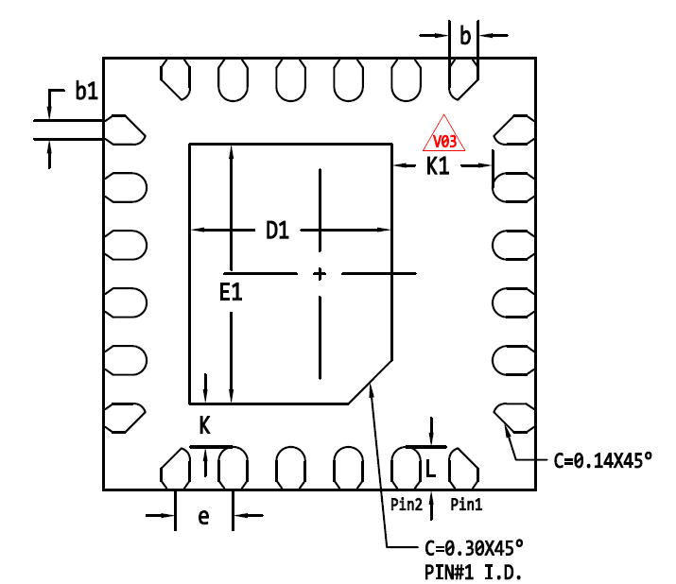
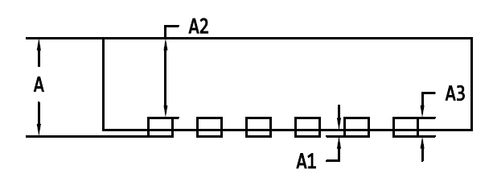
XD12
Package specification
QFN 3030-24L Package Outline
TOP VIEW
BOTTOM VIEW
E
Pin #1
D
SIDE VIEW
Symbol | Dimensions in mm
 | Min | Typ | Max
A | 0.50 | 0.55 | 0.60
A1 | 0.00 | - | 0.05
A2 | 0.45 REF
A3 | 0.152 REF
b | 0.15 | 0.20 | 0.25
b1 | 0.08 | 0.13 | 0.18
D | 2.90 | 3.00 | 3.10
D1 | 1.35 | 1.40 | 1.45
E | 2.90 | 3.00 | 3.10
E1 | 1.75 | 1.80 | 1.85
e | 0.40 BSC
K | 0.25 | 0.30 | 0.35
K1 | 0.65 | 0.70 | 0.75
L | 0.25 | 0.30 | 0.35
Figure 16. Package Outline

Slide 33
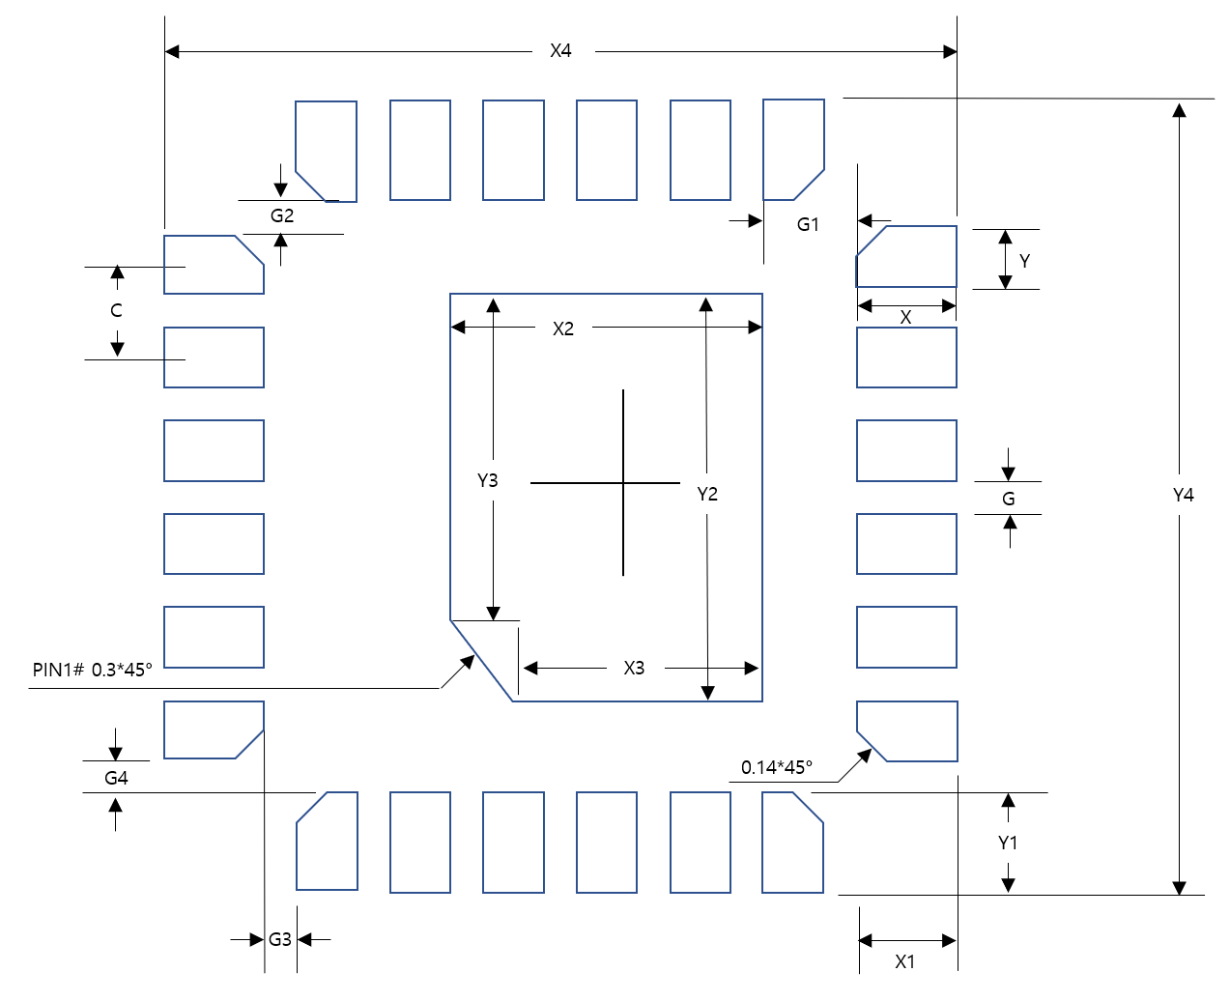

XD12
Recommended Footprint
Symbol | Dimensions in mm
 | Value | Margin (Typ+)
X | 0.5 | +0.2
Y | 0.2 | 0
C | 0.4 | 0
X1 | 0.5 | +0.2
Y1 | 0.5 | +0.2
X2 | 1.4 | +0.1
Y2 | 1.9 | +0.1
X3 | 1.1 | +0.1
Y3 | 1.6 | +0.1
X4 | 3.4 | +0.2
Y4 | 3.4 | +0.2
G | 0.2 | 0
G1 | 0.3 | 0
G2 | 0.1 | 0
G3 | 0.1 | 0
G4 | 0.1 | 0
Figure 17. Recommended Footprint
Note: The reflow peak soldering temperature is peak 260°C and it is specified based on IPC/JEDEC J-STD- 020
“Moisture/Reflow Sensitivity Classification for Non-Hermetic Solid State Surface Mount Devices”
is the trademark of Global Technologies Co., Ltd. or its subsidiaries in the Republic of Korea and/or other countries. The products of Global Technologies reserve the right to make changes without further notice to any products herein. Global Technologies makes no warranty, representation or guarantee regarding the suitability of its products for any particular purpose, nor does Global Technologies assume any liability arising out of the application or use of any product or circuit, and specifically disclaims any and all liability, including without limitation special, consequential or incidental damages. Global Technologies does not convey any license under its patent rights nor the rights of others.
is the trademark of Global Technologies Co., Ltd. or its subsidiaries in the Republic of Korea and/or other countries. Global Technologies owns the rights to a number of patents, trademarks, copyrights, trade secrets, and other intellectual property. Global Technologies reserves the right to make changes without further notice to any products herein. Global Technologies makes no warranty, representation or guarantee regarding the suitability of its products for any particular purpose, nor does Global Technologies assume any liability arising out of the application or use of any product or circuit, and specifically disclaims any and all liability, including without limitation special, consequential or incidental damages. Buyer is responsible for its products and applications using Global Technologies products, including compliance with all laws, regulations and safety requirements or standards, regardless of any support or applications information provided by Global Technologies. “Typical” parameters which may be provided in Global Technologies data sheets and/or specifications can and do vary in different applications and actual performance may vary over time. All operating parameters, including “Typical” must be validated for each customer application by customer’s technical experts. Global Technologies does not convey any license under its patent rights nor the rights of others. Global Technologies products are not designed, intended, or authorized for use as a critical component in life support systems or any FDA Class 3 medical devices or medical devices with a same or similar classification in a foreign jurisdiction or any devices intended for implantation in the human body. Should Buyer purchase or use Global Technologies products for any such unintended or unauthorized application, Buyer shall indemnify and hold Global Technologies and its officers, employees, subsidiaries, affiliates, and distributors harmless against all claims, costs, damages, and expenses, and reasonable attorney fees arising out of, directly or indirectly, any claim of personal injury or death associated with such unintended or unauthorized use, even if such claim alleges that Global Technologies was negligent regarding the design or manufacture of the part. Global Technologies is an Equal Opportunity/Affirmative Action Employer. This literature is subject to all applicable copyright laws and is not for resale in any manner.

